Slide 1

CAUSE OF DEATH ANALYSIS
By- Vinayak Patil
Internship Batch No- 34

Slide 2
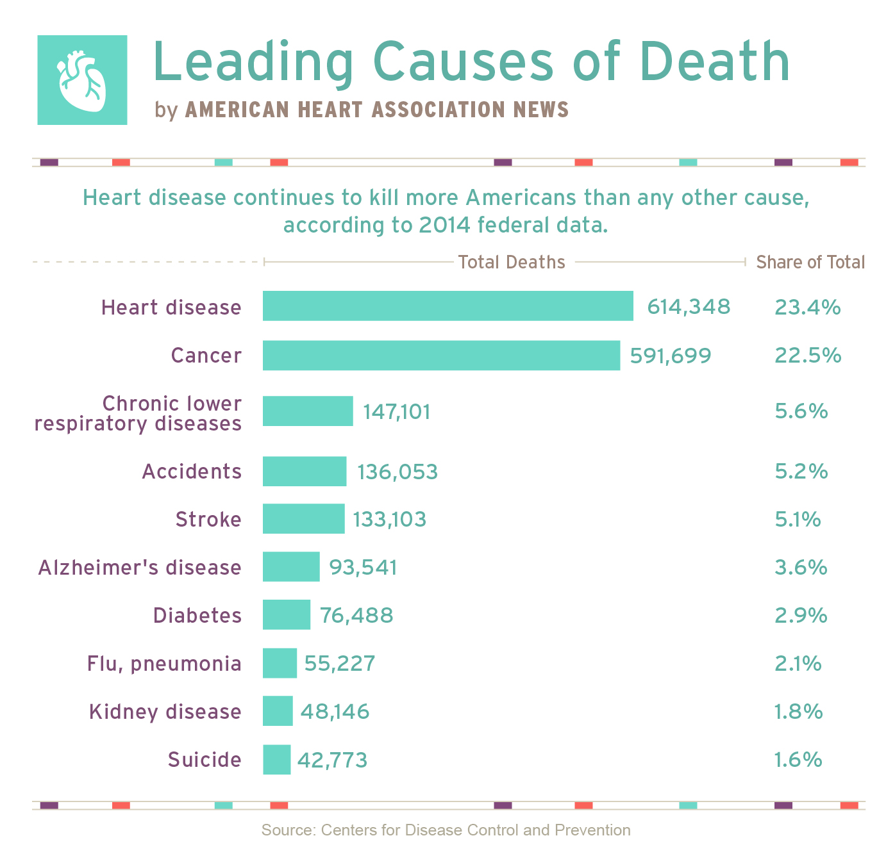
Introduction
A Straightforward way to assess the health status of population is to focus on mortality or concepts like child mortality or life expectancy, which are based on mortality estimates. A focus on mortality, however, does not take in to account that the burden of diseases is not only that they kill people, but that they cause suffering to people who live with them. Assessing heath outcomes by both mortality and morbidity (the prevalent diseases) provides a more encompassing view on health outcomes. This is the topic of this entry. The sum of mortality and morbidity is referred to as the burden of disease and can be measured by a metric called disability adjusted life years. Daly are measuring lost health and are a standardized metric that allow for direct comparisons of disease burdens of different diseases across countries, between different population and over time. Conceptually one Daly is the equivalent of one year in good health because of either premature death of disease or disability. One Daly represents one lost year of healthy life. The first global burden of disease (GBD) was GBD 1990 and the Daly metric was prominently featured in the World Bank’s 1993 World Development Report. Today it is published by both the researcher at the Institute of Health Metrics and Evaluation (IHME) and the disease burden unit at the World Health Organization (WHO), which was created in 1998. The IHME continues the work that was started in the early 1990s and publishes the Global Burden of Disease Study.

Slide 3
Problem Statement
In this Dataset, we have Historical Data of different cause of deaths for all ages around the World. The key features of this Dataset are: Meningitis, Alzheimer's Disease and Other Dementias, Parkinson's Disease, Nutritional Deficiencies, Malaria, Drowning, Interpersonal Violence, Maternal Disorders, HIV/AIDS, Drug Use Disorders, Tuberculosis, Cardiovascular Diseases, Lower Respiratory Infections, Neonatal Disorders, Alcohol Use Disorders, Self-harm, Exposure to Forces of Nature, Diarrheal Diseases, Environmental Heat and Cold Exposure, Neoplasms, Conflict and Terrorism, Diabetes Mellitus, Chronic Kidney Disease, Poisonings, Protein-Energy Malnutrition, Road Injuries, Chronic Respiratory Diseases, Cirrhosis and Other Chronic Liver Diseases, Digestive Diseases, Fire, Heat, and Hot Substances, Acute Hepatitis.

Slide 4
Conceptual Background of the Domain Problem
Causes of death(CoD) is one of the most fundamental metrics for population
health.
Trends in CoD provide an important summary of whether society is or is not making progress in reducing burden of premature mortality and especially avoidable mortality.
Usually CoD assessments show success and failures of Health information
Systems and provide directions of how to improve them.
GBD 1990 was the first comprehensive study to present the global leading
causes of death.

Slide 5
Global causes of Death Assessment
The universe of data
Efforts to assess and enhance quality and comparability of data.
The statistical modelling strategy.
Causes of death constrained to sum to all cause mortality.

Slide 6
Top down hierarchical Map
Group A:
Communicable, maternal, prenatal and nutritional conditions Intestinal infectious
Diseases ,Diarrheal disease.
Group B:
Non communicable diseases Cardiovascular and circulatory diseases, Cerebrovascular disease, Hemorrhagic stroke
Group C:
A. Unintentional injuries
1.Transport Injuries
2.Road injury
3. injury-motorized two-wheeler rider

Slide 7
Causes of death ensemble modeling
1.Causes of death ensemble modelling, CODEm(133 causes), including all major causes except HIV.CODEm selects models and ensembles of models based on out-of-sample performance.
2.Negative binomial(12 causes).
3. Fixed proportion models(27 causes)
4.Disaggregation by pathogens or sub-causes(36 causes)
5.Natural history models(8 causes)
6.Mortality shock regressions(2 causes)

Slide 8
Combining results
Because we developed single-cause models, it was imperative as a final step to ensure that individual cause estimates summed to the all-cause mortality estimate forever age-sex-country-year group.
This is one of the innovations of this study:
Implemented taking into account uncertainty in every cause of death
model outcome.
We proportionately rescaled every cause such that the sum of the cause- specific estimates equalled the number of deaths from all causes generated from the demographic analysis(by country, year, age, and sex).
We applied Cod Correct in a hierarchical way

Slide 9
Key findings
1. The shifting pattern of the number of deaths by cause across time, countries and age groups is consistent with the three key drivers of change.
2. Despite the important epidemiological shift in the world, the MDGs related deaths in Sub Sahara Africa represent 60% of all deaths in that region during 2010.
New set of analytical approaches and methods:
1. Improved diagnostic redistribution
2. The modelling strategy depends of the strength of available data: CODEM
and CoD Corrector both innovations in the field
Adding time trends and quantifying the uncertainty differentiate GBD 2010 from similar studies in the past, however without correction of known bias, comparability is impossible.

Slide 10
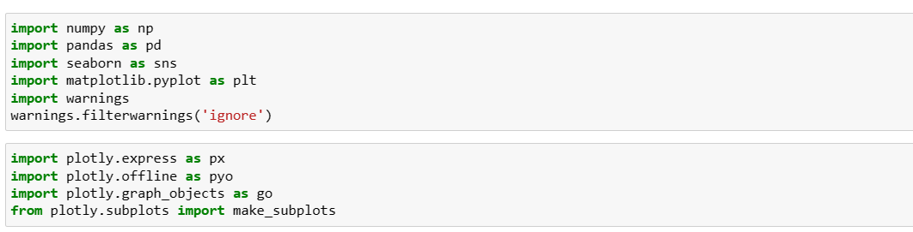
IMPORTING SOME OF THE IMPORTANT LIBARARIES

Slide 11
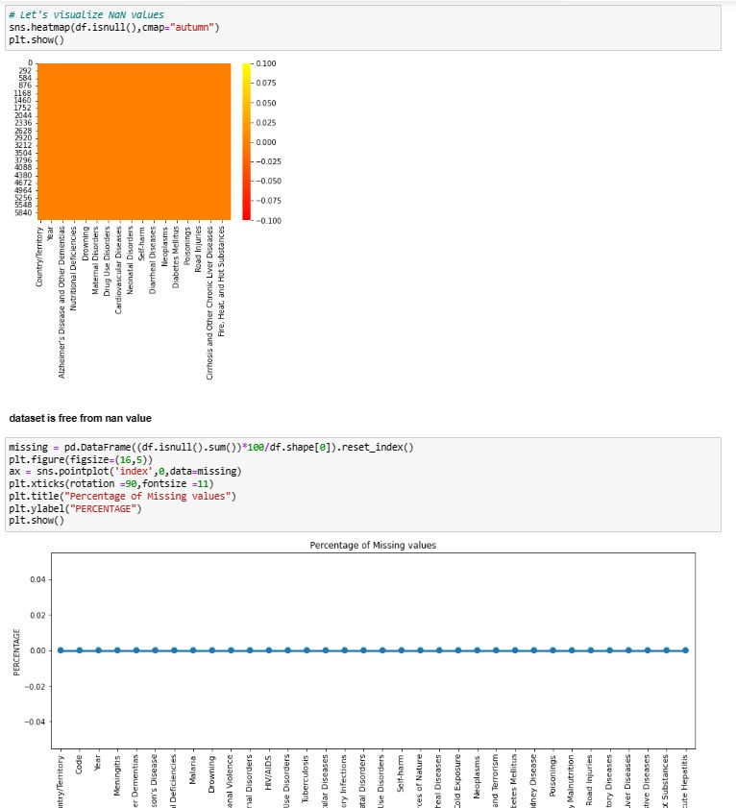
LETS CHECK NULL VALUES IN THE DATASET:-

Slide 12
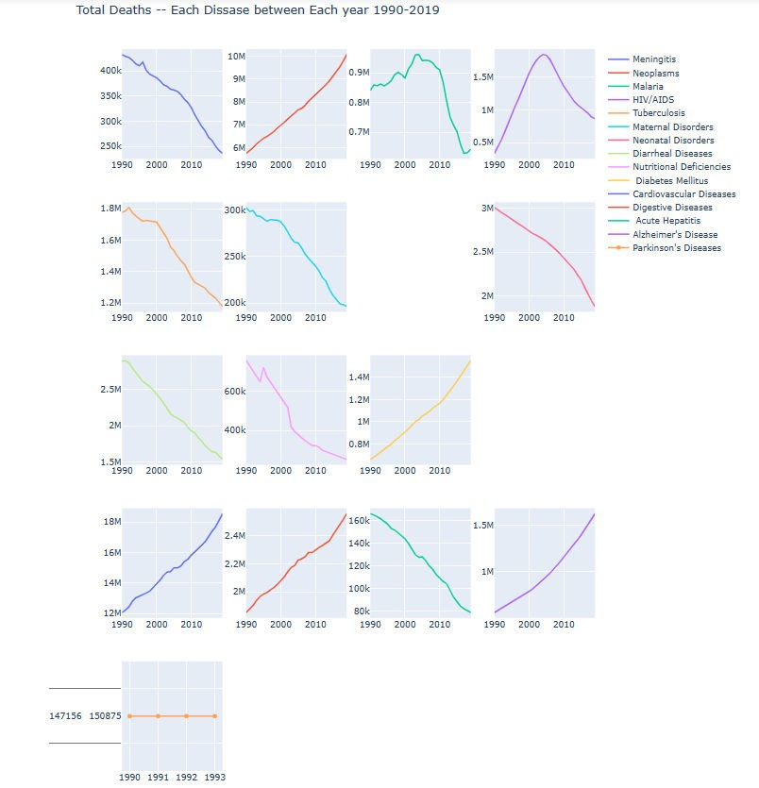
NOW DO PLOTTING OF DEATH BY DISEASES:-

Slide 13
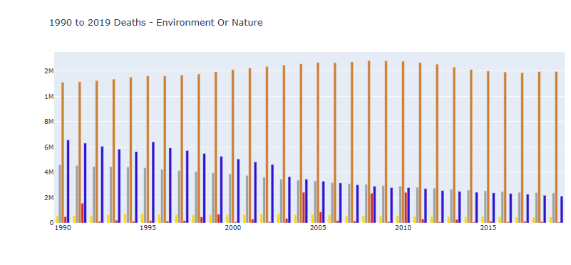
NOW LET’S SEE DEATHS TAKEN PLACE BY ENVIORNMENT AND ACCIDENT.

Slide 14
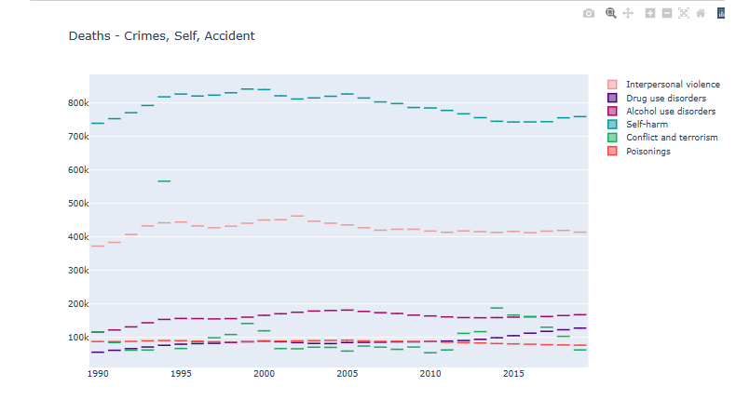
DEATH BY CRIME , TERROR ,SELF-HARM AND ACCIDENT.

Slide 15
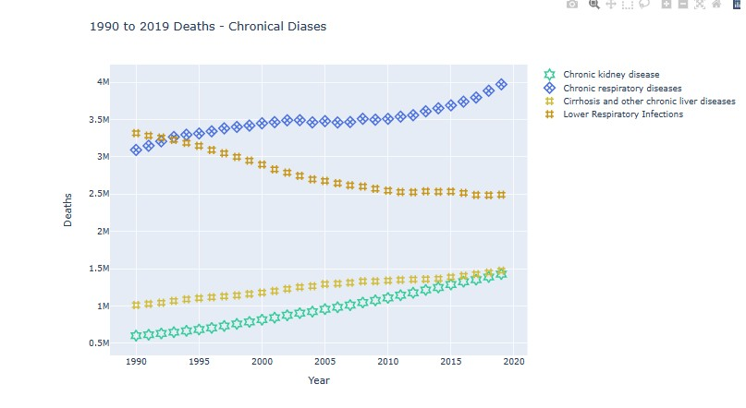
DEATH BY CHRONIC DISEASES

Slide 16
CONCLUSION:
I found out that there are many diseases which continuously increasing such as Neoplasm's, HIV/AIDS, Diabetes, Cardiovascular Diseases, Digestive disorder and Alzheimer
I Found out that there are many diseases which are continuously decreasing too such as Acute Hepatitis, Diarrheal Diseases, Nutritional Diseases and Meningitis
Parkinson Diseases seems to be constants till 1990 to 1993 after that no data is present for the same.
We can see that in all the given years i.e. 1990 to 2019, Road accident have taken Maximum life’s and the least can death can be seen in Exposure to force of Nature
In case of Death by crime, self-harm and Accident -> Maximum death have been taken place by Conflict and Terrorism and the second highest death have been recorded by -Interpersonal Violence.
ALL THE GOVERNMENT AND CONCERNED BODIES SHOULD TAKE RESONABLE STEP TO ENSURE THAT ALL THE AREAS WITH MAXIMUM DEATHS CAN BE MINIMIZED AND PROPER ACTION SHOULD BE TAKEN

Slide 17


